Slide 1
CSE302-Software Quality Engineering Software Quality Metrics
Instructor: Sobia Usman
Assistant Professor
CS - CUI, LHR

Slide 2
Product Metrics
Product metrics are those that describe the characteristics of the product such as size, complexity, design features, performance, and quality level

Slide 3
Product Metrics
Mean time to failure (MTTF)
Defect density
Customer problems
Customer satisfaction

Slide 4
Mean Time To Failure
The mean time to failure metric measures the time between failures
It is often used with safety-critical systems such as the airline traffic control systems, avionics, and weapons
For example, the air traffic control system cannot be unavailable for more than three seconds a year

Slide 5
Mean Time To Failure
A MTTF of 200 means that one failure can be expected every 200 time units.
A failure occurs when a functional unit of a software-related system can no longer perform its required function or cannot perform it within specified limits

Slide 6
Defect Density
The defect density measures the number of defects discovered per some unit of software size (lines of code, function points)
The defect density metric is used in many commercial software systems
The defect rate of a product or the expected number of defects over a certain time period is important for cost and resource estimates of the maintenance phase of the software life cycle

Slide 7
Defect Density
Defect Density is the number of defects confirmed in software/module during a specific period of operation or development divided by the size of the software/module.
Thus, if a 150 LOC program had 18 defects,
The defect density would be
1000*(18/150) = 120 defects/KLOC

Slide 8
Customer Problems
This metric is a simple count of the number of new (non-duplicate) problems reported by customers over some time interval
When measured at regular intervals and plotted, the data can be used to identify a trend. Although, a trend may be apparent, it is more useful to determine the reasons behind the trend

Slide 9
Customer Problems
Problems metric is usually expressed in terms of problems per user month (PUM):
PUM = Total problems that customers reported (true defects and non-defect-oriented problems) for a time period÷ Total number of license-months of the software during the period
Problems that are not valid defects may be
usability problems,
unclear documentation or information,
duplicates of valid defects
user errors

Slide 10
Customer Satisfaction
A measure of how products and/or services supplied by a company meet customer expectation.
It can be use as a basis of monitoring, evaluating and developing new products and process that contribute to company’s performance management.
Provides an indication of how successful the organization is at providing products and/or services to the marketplace.

Slide 11
Customer Satisfaction
This metric is typically measured through a customer satisfaction survey
Very satisfied
Satisfied
Neutral
Dissatisfied
Very dissatisfied

Slide 12
Customer Satisfaction
Customer Satisfaction is typically measured through
Directly contacting customers and getting their valuable feedback
Call centers, complaint handling department could be treated as first point of contact for getting customer feedback. (these feedbacks are compiled to analyze customers’ perception)
Customer feedback through surveys and questionnaires.

Slide 13
Metrics for Software Maintenance Process

Slide 14
Metrics in Software Maintenance
During this phase the defect arrivals by time interval and customer problem calls (which may or may not be defects) by time interval rate are the de facto metrics
However, the number or problem arrivals is largely determined by the development process before the maintenance phase
Not much can be done to alter the quality of the product during this phase. Therefore, the de facto metrics, while important, do not reflect the quality of software maintenance

Slide 15
Metrics in Software Maintenance
What can be done during maintenance phase is to fix the defects as soon as possible and with excellent fix quality
Such actions, although still not able to improve the defect rate of the product, can improve customer satisfaction to a large extent

Slide 16
Metrics in Software Maintenance
Fix backlog
Backlog management index
Fix response time
Percent delinquent fixes
Defective fixes

Slide 17
Fix Backlog
The fix backlog metric is a count of the number of defects in the product following its release that require a repair
It is a simple count of reported problems that remain at the end of each month or each week.
It is usually measured at regular intervals of time and plotted for trend analysis

Slide 18
Fix Backlog
A more useful way to represent the fix backlog is by defect severity
By calculating the fix backlog by severity level, you can begin to draw useful conclusions from your measurements

Slide 19
Backlog Management Index
The backlog management index (BMI) is calculated by dividing the number of defects closed during some period of time by the number of new defects that arrived during that same period of time
BMI =Number of problems closed during the month/Number of problem arrivals during the month ×100%

Slide 20
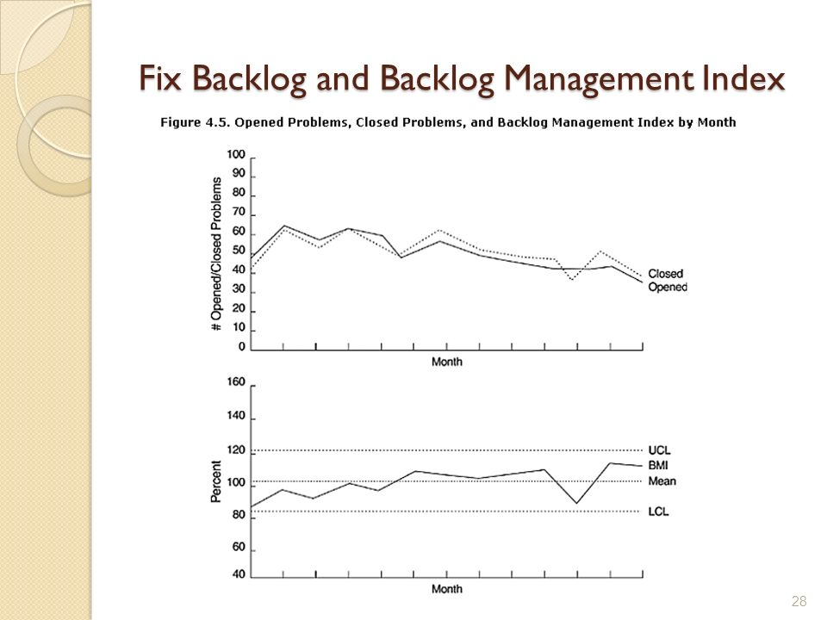
Defect Backlog

Slide 21
Backlog Management Index
As the backlog is worked, new problems arrive that impact the net result of your team’s efforts to reduce the backlog
If the number of new defects exceeds the number of defects closed over some period of time, your team is losing ground to the backlog.
If, on the other hand, your team closes problems faster than new ones are opened, they are gaining ground

Slide 22
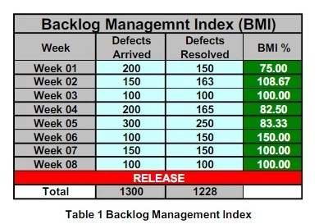
Backlog Management Index
If BMI is larger than 100, it means the backlog is reduced.
If BMI is less than 100, then the backlog increased.
When measurements are taken at regular intervals and plotted, a trend can be observed indicating the rate at which the backlog is growing or shrinking

Slide 23
Fix Response Time
The fix response time metric is determined by calculating the average time it takes your team to fix a defect
The fix response time metric is usually calculated as follows for all problems as well as by severity level:
Mean time of all problems from open to closed
Short fix response time leads to customer satisfaction

Slide 24
Fix Response Time
For many software development organizations, guidelines are established on the time limit within which the fixes should be available for the reported defects.
Usually the criteria are set in accordance with the severity of the problems.
For the critical situations in which the customers' businesses are at risk due to defects in the software product, software developers or the software change teams work around the clock to fix the problems.
For less severe defects - the required fix response time is more relaxed.

Slide 25
Percent Delinquent Fixes
A fix is delinquent if exceeds your fix response time criteria. In other words, if you have established a maximum fix response time of 48 hours; then fix response times that exceed 48 hours are considered delinquent
To calculate the percent delinquent fixes; divide the number of delinquent fixes by the number of non-delinquent fixes and multiply by 100
PDF = (F_{d} / F_{n}) * 100

Slide 26
Percent Delinquent Fixes
This metric is also measured better by severity since the consequences of having a high delinquent fixes for severe defects is typically much greater than for less severe or minor defects

Slide 27
Defective Fixes
A defect for which a fix has been prepared that later turns out to be defective or worse, creates one or more additional problems, is called a defective fix
The defective fixes metric is a count of the number of such fixes

Slide 28
Defective Fixes
To accurately measure the number of defective fixes, your organization must not only keep track of defects that have been closed and then reopened but must also keep track of new defects that were caused by a defect fix
This metric is also known as fix quality

